Slide 1

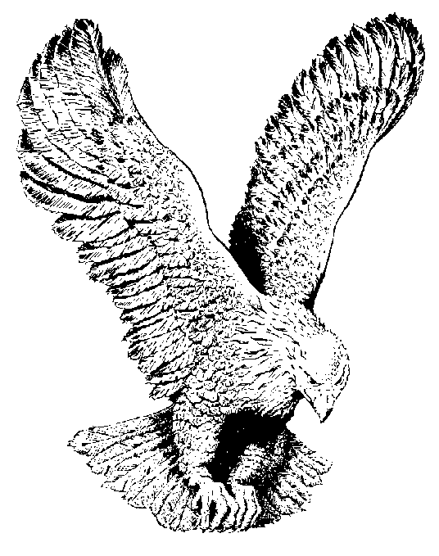
212
I BELIEVE GOD
I believe God! I believe God!
It shall be done, even as He said;
Trust and obey, look up and say,
I believe, I believe God.

Slide 2
I believe God! I believe God!
Ask what you will and it shall be done;
Trust and obey, believe it and say:
I believe, I believe God.

Slide 3
And if you want salvation now
And the Holy ghost and power,
Just trust and obey, believe it and say:
I believe, I believe God.

